Slide 1
Hiring Process Analytics
Aaditya Singh
Trainity

Slide 2
Project Description
I was tasked to analyze the MNC’s hiring process data and draw meaningful insights from it.
The hiring process is a crucial function of any company.
We need to understand various types of trends. For example, these trends could be number of rejections, interviews, job types, and vacancies.
Such analysis can provide valuable insights for the hiring department.
I used my knowledge of statistics and Excel to draw meaningful conclusions about the company's hiring process.
I hope my insights could potentially help the company improve its hiring process and make better hiring decisions in the future.

Slide 3
Approach
Before actually performing data analysis, we need to get out hands dirty with the unclean data.
I was provided with a series of steps to perform in order to clean the data.
Step 1: Handling Missing Data- Here I made use of ‘Find and Select’ feature in the editing section of the home ribbon. I selected the Go To Special option and selected ‘Blanks’. This returned me with 1 blank value which was deleted by me as a cleaning process.
Step 2: Clubbing Columns- No columns needed to be clubbed.
Step 3: Outlier Detection- The filters were active since this was a table and when I checked out the salary column of the sheet, I found out the salary of 3 individuals to be very high. Along with this, I also opted to remove the rejected candidates as their information would have skewed the data.

Slide 4
Approach
Step 4: Removing Outliers- After identifying the outliers, I removed them.
Step 5: Data Summary- Now that all the outliers were removed, we perform some final touches and smoothing of the data so that it is easily understandable and readable. So I changed the column name of ‘event_name’ to ‘gender’, since the values were gender (male, female, etc.). Along with this I created a separate sheet named as ‘Analysis’ for some visualization space. There were some data in the columns which were ‘-’ and we chose to ignore it as someone had asked a doubt regarding the hyphen (whether to treat it like a outlier or not).

Slide 5
Tech-Stack used
I am using Microsoft® Excel® 2019 MSO (Version 2311 Build 16.0.17029.20028) 64-bit for this project.
MS excel is a spreadsheet application and has various use cases but its selling points are- creating Dashboards, Advanced formulas, Data Analysis and many more advanced features.
MS excel saves your work locally and on cloud servers and provides a brief visual interface.
To create a report I have used Microsoft PowerPoint 2019.

Slide 6

Insights
Hiring Analysis: Determine the gender distribution of hires. How many males and females have been hired by the company?
We will use the ‘Pivot table’ function in the Insert tab of the ribbon.
Select the data needed. In this case, the gender column and the Count of gender column.
Then we simply rename the default names according to our need.

Slide 7
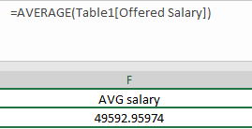
Insights
Salary Analysis: What is the average salary offered by this company? Use Excel functions to calculate this.
As seen above, we have used the AVERAGE formula to find out the average salary offered by the company.
This average is of hired employees currently working in the MNC.

Slide 8
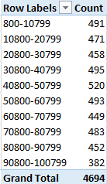
insights
Salary Distribution: Create class intervals for the salaries in the company.
We again use the Pivot table, here we select the salary column and use it as row. Then we select its count. Finally we Group the data of salary column in intervals of 10,000.

Slide 9
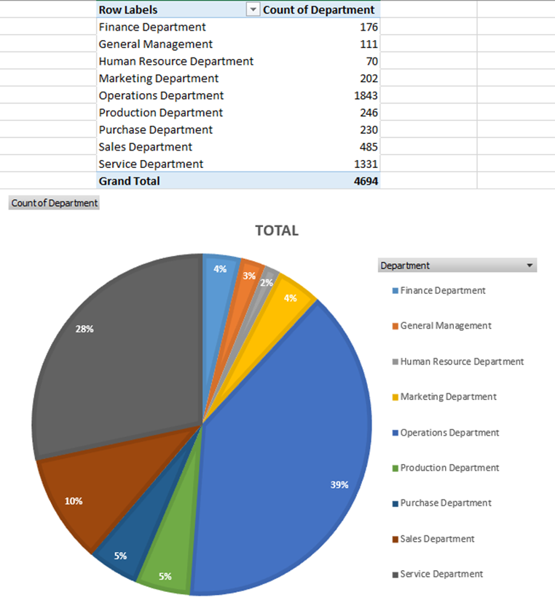
insights
Departmental Analysis: Use suitable visualization to show the proportion of people working in different departments.

Slide 10
insights
Along with Pivot table, we make use of another function in the Insert tab.
‘Insert Pie or Donut chart’ was used to create a suitable pie chart for our table.
Further we selected a style and edited the data label a bit for better readability purpose.

Slide 11
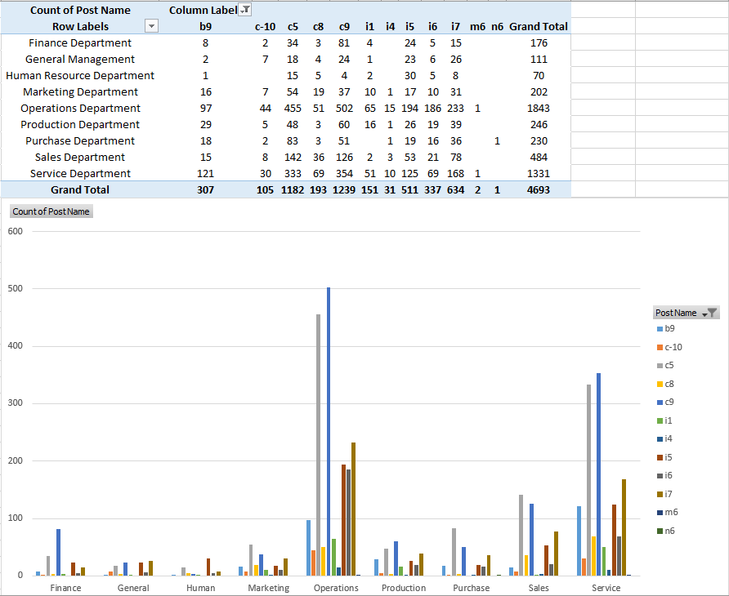
insights
Position Tier Analysis: Use a chart or graph to represent the different position tiers within the company.

Slide 12
insights
Here, we needed to find out distribution of positions across different tiers.
Basically it means we needed a value of how many employees of which department are in which post.
With the help of pivot table, it was possible to use the Department column along with the post name column.
Later we used the clustered column chart for a clear side-by-side comparison of post tiers in the company.

Slide 13
Result
We found out that there are 1854 Female and 262 Male employees in the company.
The average salary is 49,592.9
Most of the employees have their salary ranging between 40,800-50-799
The biggest department in the company is ‘Operations Department’ boasting 39% and the smallest department is ‘Human Resource Department’ with only 2%.
The post tier ‘c9’ is most common in all the departments, followed by post tier ‘c5’. The post tier ‘n6’ has only 1 employee in the purchase department.

Slide 14
Drive link
Hiring process analytics excel sheet

